Slide 1
BlueROV Electrical Block Diagram
BlueRoboticsPressure / Temp. Sensor
6600 mAh 4s Lipo Battery
14.8vdc
XT90
XT90
I2C Expander
3DR uBlox GPS with Compass
Compass
+14.8 vdc
XT60
XT60
3DR Power Module
Power
5 vdc
I2C
GPS
GPS
XT60
3DR Pixhawk
Autopilot
JST-XH
BatPwr In
(connect to aux. output - see Sht. 3)
Pressure Enclosure
+14.8 vdc
XT60
Power 5 vdc
1.2A
Buzzer
Raspberry Pi 2
Model B
Raspberry Pi Camera Board
Terminal Board
Terminal Board
Main ESC PWM
Thruster Ctrl
micro USB
+14.8 vdc
Gnd
USB
JST-XH
Main
Outputs
See Sht. 3
……6x…..
JST-XH
Buzzer
(Optional)
Ctrl / Data
Ethernet Tether
Basic 30A ESC
ESCs ……6x…..
Basic 30A ESC
T200 Thruster
T200 Thruster
Topside (Laptop)
Thrusters ……6x…..
20160310
Sht 1
BlueROV-Block-Diagram-20160229.pptx

Slide 2
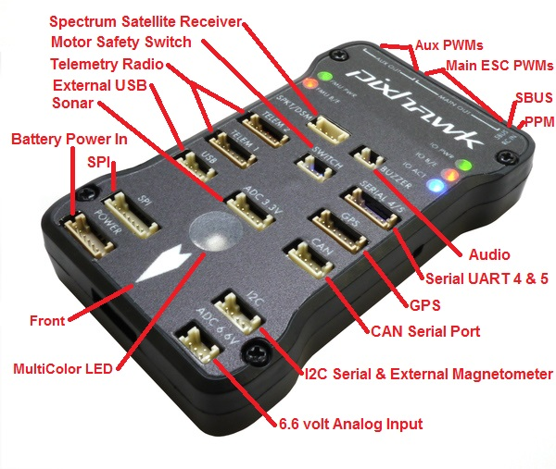
Pi Data connects to Pixhawk via MicroUSB
Pixhawk Overview
Connect here for Raspberry Pi 5v power
Connect ESCs Control 1-6 Here
Connect 3DR Power Module Pigtail Here
Buzzer (Optional)
3DR uBlox GPS
Connect I2C Expander
Then connect uBlox Compass and BlueRobotics Depth Sensor to Expander
Ref: http://copter.ardupilot.com/wiki/common-pixhawk-overview/
Sht 2

Slide 3
Pixhawk connector assignments
Comms (to Rasp. Pi2)
Pwr Input (from module)
Warning Buzzer (optional)
Signal from GPS/Compass
Connect I2c Expander which is connected to uBLOX compass and Bluerobotics depth/temp. sensor
Thruster ESCs - PWM
Rasp. PI +5v / - Gnd.
Sht 3
Ref: http://copter.ardupilot.com/wiki/common-pixhawk-overview/

Slide 4
3DR UBlox GPS + Compass Module This page covers the installation of the 3DR UBlox GPS + Compass module.
Pressure Sensor
I2c Exp
Ref: http://copter.ardupilot.com/wiki/common-installing-3dr-ublox-gps-compass-module/
Sht 4

Slide 5
3DR Power Module This page explains how to set up the 3DR Power Module (PM) to measure battery voltage and current consumption. The information will also be useful for setting up other types of Power Module.
To BlueROV
Terminal Board +/Gnd
XT60 Connector
To Pixhawk Power Input Conn.
Ref: http://copter.ardupilot.com/wiki/common-3dr-power-module/
Sht 5

Slide 6
Comments:
1. The “safety sw” is currently disabled in our recommended
2. I would recommend supplying power to the Raspberry Pi via one of the auxiliary outputs (shown on page 3 of your slides)
3. If you are planning to use a pressure sensor for depth, you will need to use the I2C expander that comes with the PixHawk to connect both the pressure sensor and GPS/compass. (Slide 4)

